Slide 1
Welcome to Origin Code Academy!
Cameron wilby / jeff winkler

Slide 2
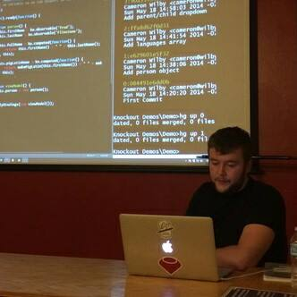

Instructors for this class
Cameron Wilby
Jeff Winkler
Mentor / Technical Instructor
Freelance Web Developer
Mentor / Career Instructor
Founder of GymXchange
Notes:
Cameron Wilby
(Background on me)
I studied for 4 years to get my masters in software development at a university in the UK
I’ve been consulting as a freelance web developer for the last 7 years
I’ve worked on software applications in several industries, specifically financial and real estate.
I’ll be your main instructor/mentor, teaching you software techniques day to day and guiding you in your technical learning.
Jeff Winkler
Jeff will also be your mentor, he has lots of real world experience in the startup world. I’ll let him introduce himself.
(Background on Jeff)
Joshua Angulo
Josh isn’t here today, but that’s because he’s based in LA.
Josh is basically a Microsoft rockstar. He’s a certified application developer with over 10 years of experience managing windows and web based applications.
He’s currently the lead programmer at a company that provides an application that manages Chapter 7/13 bankruptcy cases, but before that he worked at Cheezburger Inc, building the site that had the funny cats all those years ago.
He’ll be available on Slack most of the time to answer any technical questions you might have.

Slide 3
Origin Students
(That’s you!) Introduce yourself to the group.
What’s your name?
What’s your favorite app?
What’s your favorite food?
Notes:
Your turn!

Slide 4
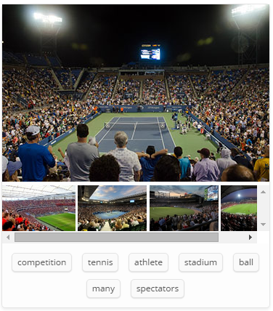
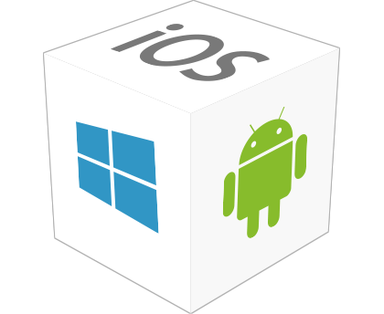

What are the goals of this course?
Not to teach you everything there is to know about programming in twelve weeks.
Notes:
First of all, I think it should be obvious that the goal of this course is not to make you expert software developers in two weeks.
After you learn the basics of programming, there are literally thousands of different ways you can apply those programming skills as a software developer. Here’s just 3 paths:
1. You could focus on mobile development, building apps for iOS, Android and Windows Phone.
2. You could focus on financial software development. For example, there is software out there that automatically analyzes the stock market to maximize the profit from trading shares. (These trades can take place in fractions of a second)
3. You could focus on scientific development. Google recently came out with software that essentially reverse engineers how our brains work to visually identify what’s going on in an image.
These are just 3 examples of ways that programming is used in todays world. Trust me, there are tonnes more.

Slide 5
What are the goals of this course?
1. Introduce you to the basics of programming.
2. Introduce you to web application development.
3. Introduce you to desktop application development.
4. Spark an interest in building more cool stuff once you’ve finished the course.
Notes:
With that out of the way, the goals of this course are:
Introduce you to the basics of programming
Introduce you to web application development
Introduce you to desktop application development
Spark an interest in building more cool stuff once you’ve finished the course.
That last one is the most important. We want you to get the “programmer’s itch”.

Slide 6
What will the Course cover?
Week One
Topics Version Control (GitHub) Basic HTML5 and CSS Responsive Design with Bootstrap Basic JavaScript and jQuery Projects Random Quote Machine Local Weather App “What’s on Twitch” using Twitch.tv API
Week Two
Topics Introduction to the .NET Framework Basic C# Programming Building Console Applications Building Desktop Applications Projects Mortgage Calculator (Console) Weather App (Console) “Are they open?” using Yelp API (Desktop)
Notes:
Here’s a brief overview of what the course will cover.
In the first week, we’ll start by setting you up with GitHub so you can build applications that run inside of a web browser. By the end of the week, your goal is to build three apps.
A random quote machine that can present a famous quote on the screen at the click of a button.
A “local weather” app that will display the user the current weather wherever they are in the world.
A “What’s on Twitch” app that will show users who is online/offline on Twitch.Tv – a popular game streaming service.
In the second week, we’ll move on to building applications that run on a users local machine. There will be a lot to cover here, your goal again will be to build three apps.
- A mortgage calculator that shows a user what their monthly payment would be on a house after entering some basic information.
- A weather app similar to the first week, except you’ll be able to choose from multiple cities as well as the current location
- An “Are they open?” app that will tell users in big bold letters whether a company is currently open or not.
If you build at least one of the apps each week, that will be a huge success.

Slide 7
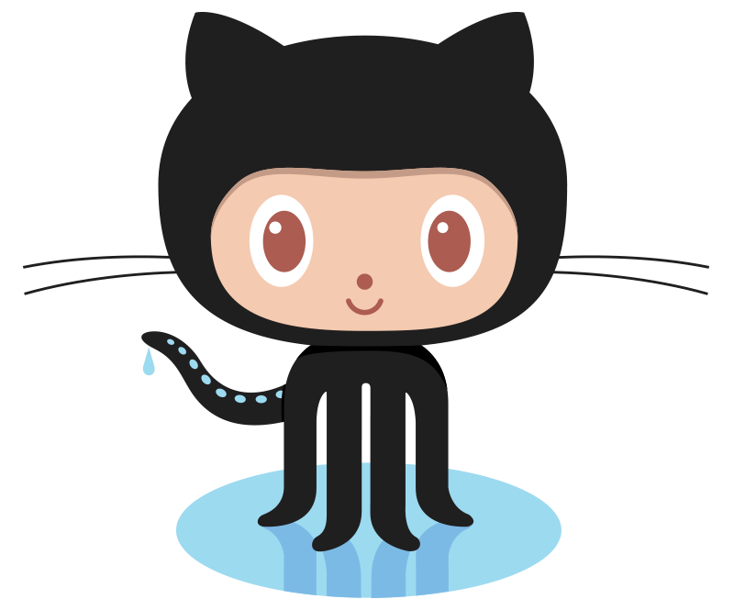
Let’s get to work.
Step One – GitHub
(AKA the most valuable tool we’ll be teaching you to use.)
Notes:
Step 1 – GitHub
GitHub is one of the most important tools that we will be teaching you how to use. It’s used by Twitter, Facebook, Microsoft and Google to name a few big companies – but it’s also used by more than 10 million people, contributing to over 25 million projects around the globe.
So.. what is it? Let’s break it down.

Slide 8

Git
- Git is a Version Control System.
Central Repository
Notes:
First, let’s talk about the “Git” in GitHub.
1. Git is a “version control system”. It is something you install on your machine and primarily use in the command prompt.
2. When teams of developers are creating something (an application for example), they are making constant changes to the code and releasing new versions up to and after the first official release.
3. A version control system allows teams to keep track of all these changes that are made, and store these changes in a central repository.
This allows developers to easily collaborate, as they can download the latest changes made to the code, make changes and then finally upload their changes.
Every developer can see these new changes, and go ahead and download, alter and upload their own changes.
This is how teams of developers work together on a single application.
There are other version control systems out there such as Subversion, CVS and Mercurial that ultimately do the same thing, but the most popular and well known version control system used right now is Git.
We’ll go further into the details of Git soon, but for now all you need to know about Git is that It’s a version control system, it keeps track of changes, and it makes it easier for developers to work together.

Slide 9
Review
Q: What type of system is Git?
A: Version Control System
Q: What is another example of a Version Control System?
A: Subversion, CVS, Mercurial
Q: How many people use Git?
A: Over 10 million people (for now..)
Notes:
Review:
Q: What type of system is Git?
A: Version Control System
Q: What is another example of a version control system?
A: Subersion, CSV, Mercurial (Or other, do not accept Dropbox or SkyDrive)
Q: How many people use Git?
A: 10m for now

Slide 10
GitHub
GitHub
Notes:
Now, let’s talk about the “Hub” in GitHub.
We now know that Git is a version control system that developers use to keep track of their changes. So what’s GitHub?
GitHub is the purple Central Repository box that I showed you a couple of slides ago.
Developers download the latest changes to code from GitHub using Git, make changes to the code on their machine, and then upload those changes to GitHub, again using Git.
Let’s walkthrough a couple of key terms associated with GitHub to give you a better understanding of what it is and why it is used.

Slide 11
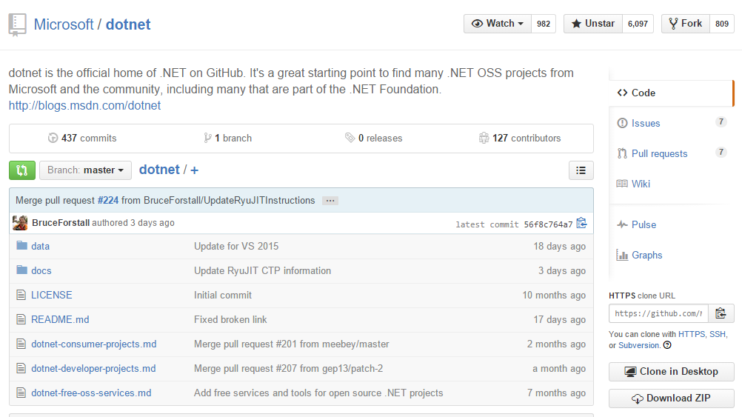
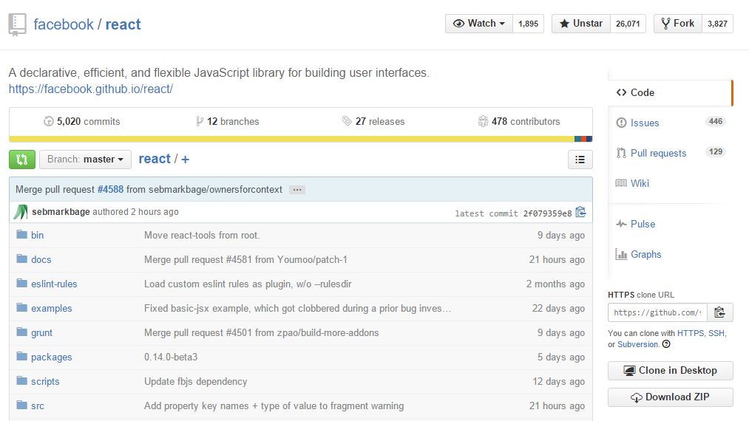
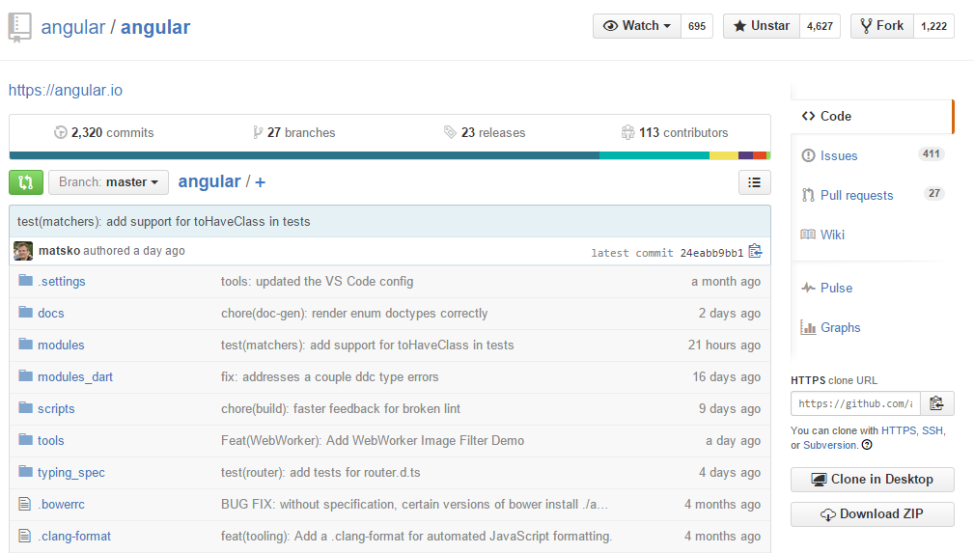
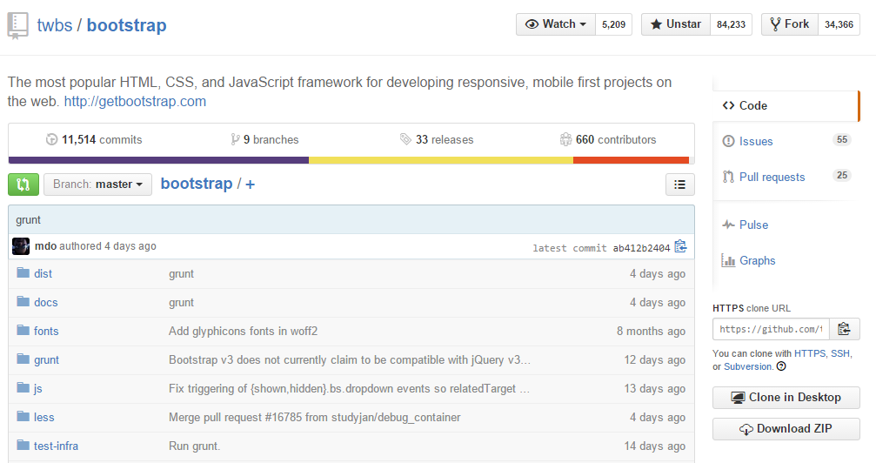
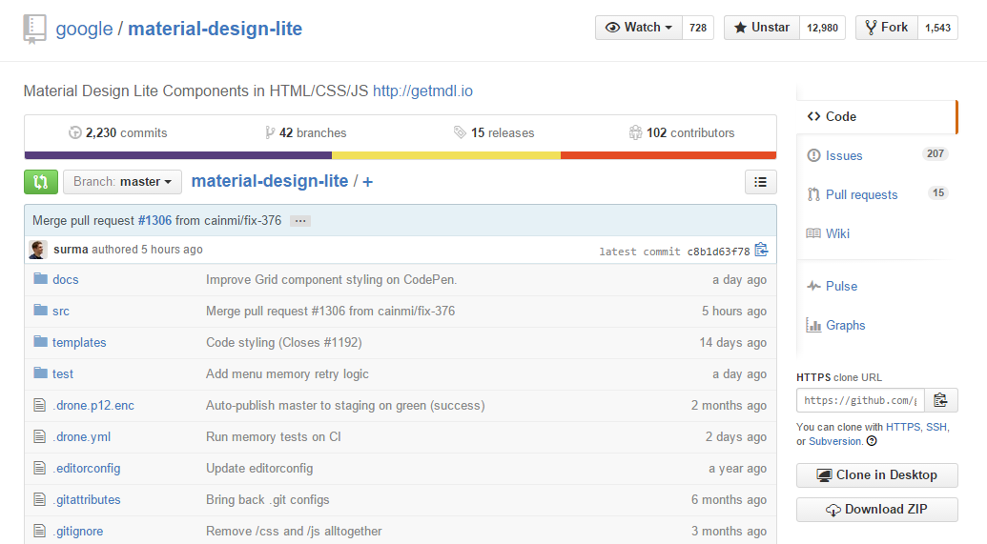
GitHub
Repository A location where all the code files for a particular project are stored.
See examples of repositories at https://www.github.com/explore
Notes:
Repository
Repositories are a location where all the code files for a particular project are stored.
Each project will have it’s own repository, and can be accessed by a unique URL.
You can see examples of some repositories on GitHub by going to https://www.github.com/explore.

Slide 12
GitHub
Repositories on GitHub can either be Public (Free!) or Private ($$$)
Every repository has a..
Changelog A history of all the changes made to the repository.
Issue Tracker A list of “to do” items relevant to the repository.
Star Count The number of people that have starred the repository (Equivalent to Facebook Likes)
Fork Count The number of people that have forked the repository

Slide 13
GitHub
Forking The act of creating a new repository based on an existing repository.
Forking is essentially copying a repository.
At first, it is a one way street.
Forks are used to…
Report the bug
Use a repository as a starting point for your own idea
Propose changes to someone else’s repository
Fix the bug yourself
Notes:
1. Forking
Forking is the act of creating a new project based on an existing project.
2. Another way of putting it – forking is essentially copying a repository, allowing you to freely experiment with changes without affecting the original repository.
3. Forking is at first, a one way street. You can pull any updates to the original repository into your fork, but you cannot push your changes back into the original repository without permission from the repository owner.
4. Most commonly, forks are used to
5. To use someone else’s repository as a starting point for your own idea or
6. Propose changes to someone else’s repository
A great example of forking is to fix a bug in a repository that doesn’t belong to you.
Let’s say you find a bug in a repository. You can do one of two things.
Report the bug to the repository owner and hope they fix it at some point
Fix the bug yourself by forking the repository, making the necessary changes and submitting a pull request to the repository owner.
If they like what they see in the pull request, they will accept it – and pull your changes into the original repository.

Slide 14
GitHub
Pull Request Requesting the repository owner to pull changes you made in a fork back into the original repository.
Owner
Improve the quality of your code.
Maintain control over the content of your repository.
Contributor
Contribute to a project
Gain recognition for your effort
Notes:
1. So, just to clarify that last part – a Pull Request is asking the repository owner to pull changes you made in a fork of their origin repository, back into the original repository.
This gives the repository owner control over the changes that are made by others to their repository. If the bug fix is no good, they may reject the pull request. If it is good, they can accept the pull request, and the changes are automatically brought into their repository.
To recap,
2. If you are the owner of a repository, pull requests give you a way to
3. Improve the quality of your code by delegating bug fixes to other people, while
4. Still maintaining control over the content of your repository.
5. If you are not the owner of a repository, forking and pull requests give you a way to
6. Contribute to a project
7. Gain recognition for your effort by having that request associated with you.
Employers will sometimes look at a candidates GitHub profile to see how much they have contributed on GitHub.
When you contribute to a project, you’re essentially showing your “programming chops” to the world and prospective employers.

Slide 15
Review
Q: What is a Repository?
A: A location where all the code files for a particular project are stored.
Q: What is a pull request?
A: Requesting that your fork be pulled into the original repository.
Q: What does forking not allow you to do without a pull request?
A: Push changes back into the original repository

Slide 16
Workshop – Let’s get you setup on GitHub!
Notes:
Create an account with GitHub
Install Git on your machine
Create your first repository
Push it to GitHub
Make a change to a file
Push it to GitHub again

